Slide 1
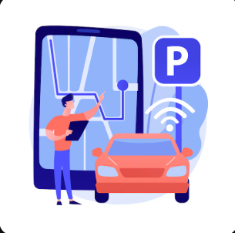
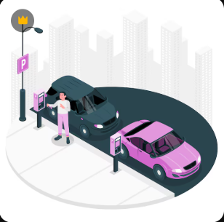
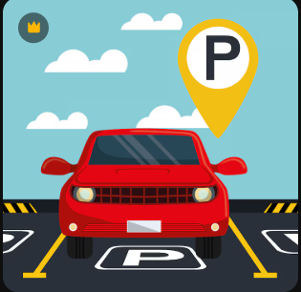
ParkPal
UX Case Study
Mentors:
Researcher & Designer:
Kirubakaran V (2023503546)
Perumall rishi P (2023503551)
Sowmiya Narayanan (2023503582)
Dharanidharan L (2023503508)
Sibichakaravarthi (2023503027)
Soorya Prakash R (2023503502)
Duration:

Slide 2
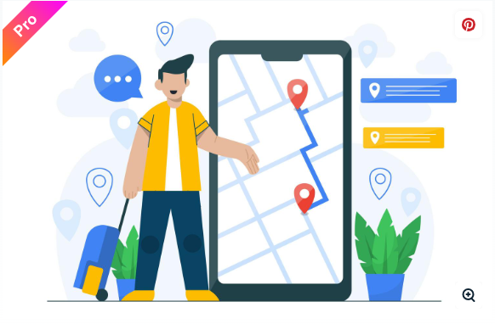
What is ParkPal?
ParkPal is a smart parking solution for urban drivers frustrated by wasted time, fuel, and stress while searching for an open parking spot. It connects drivers with real-time available parking, leveraging accurate data and a simple, reliable interface. ParkPal aims to reduce traffic congestion, and carbon emissions, and provide a seamless parking experience.

Slide 3
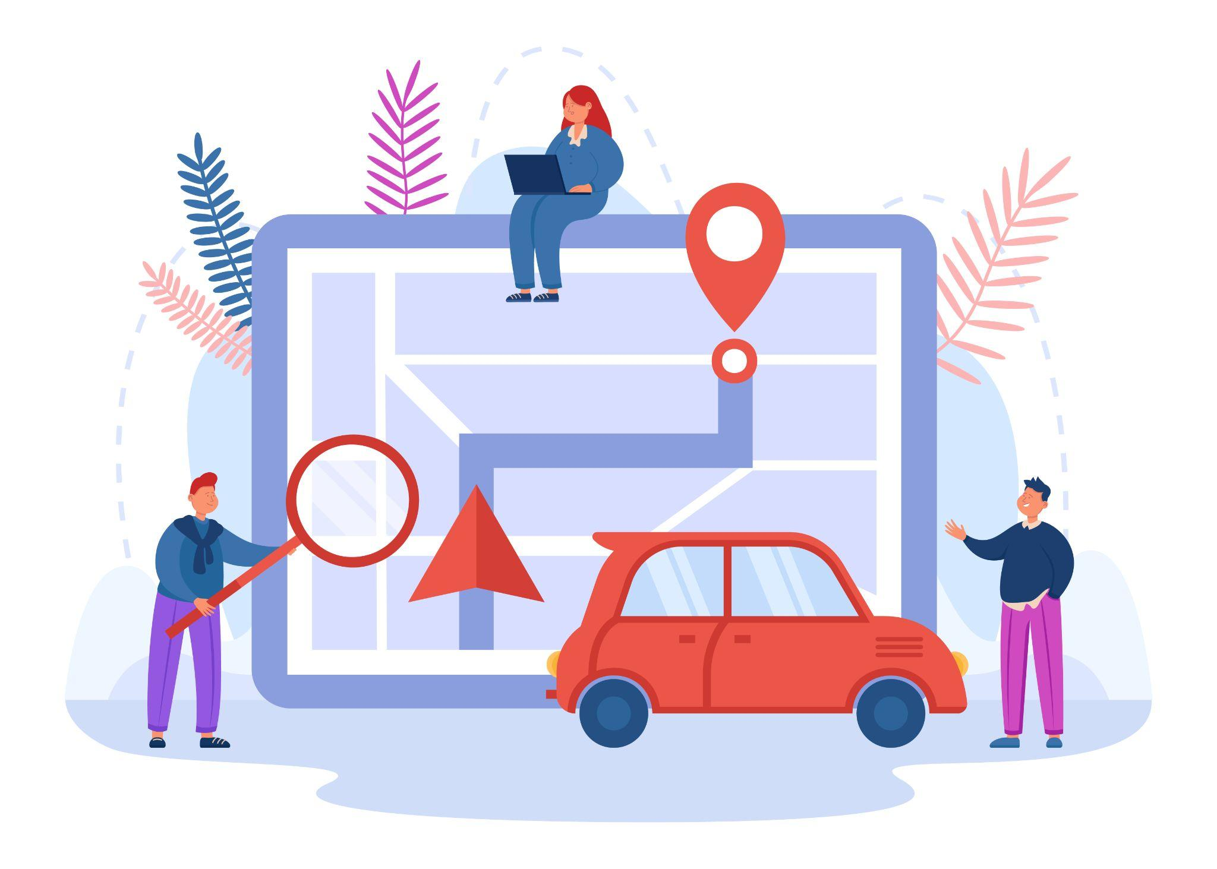
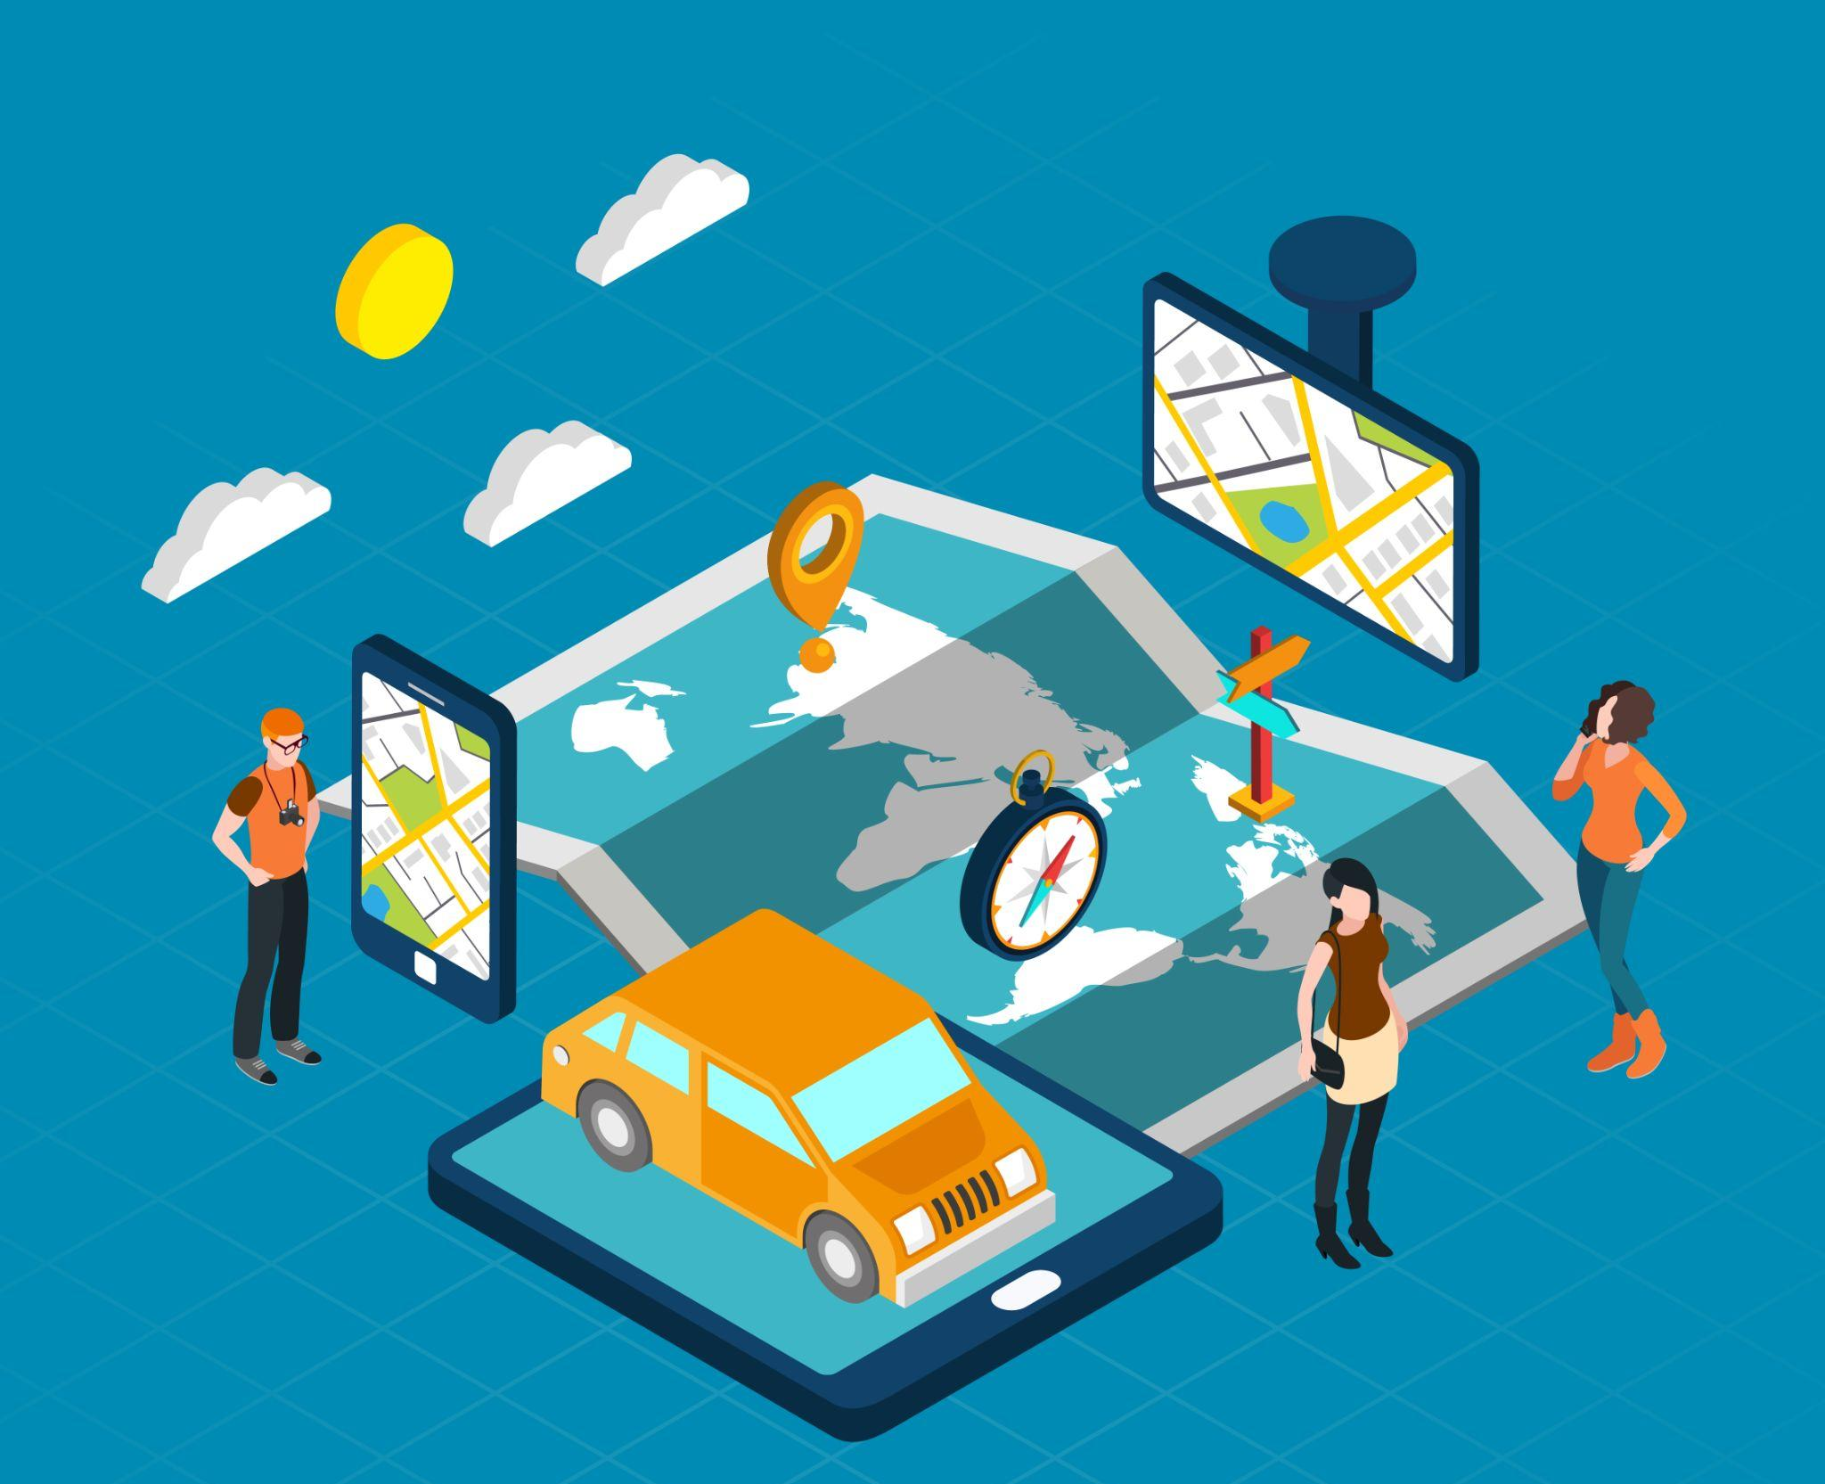
Problem Statement
Difficulty finding real-time available parking in busy cities.
Wasted time, fuel, and productivity due to inaccurate or outdated information from existing apps.
Frustrating user experiences because of complex app interfaces.
Contributing to city traffic and environmental pollution.
Proposed Solutions
Real-time, accurate parking availability maps.
Integration with smart sensors and crowd-sourced updates.
Simple, minimal interface for quick use while driving.
Route guidance directly to the nearest vacant spot.
Options for advance bookings and digital payments.
Community features for reporting and verifying spot accuracy.

Slide 4




Design Process
Understand
Define
Ideate
Design
User interviews with city drivers, parking lot owners, municipal authorities.
Competitor analysis of leading parking apps.
Field observations of parking search challenges.
Define what makes parking search frustrating.
Map out varied user journeys (daily commuters, shoppers, visitors).
Brainstorm features: live feed, booking, spot verification, incentives for reporters.
Sketch wireframes with minimal UI for use on the go.
Create high-contrast, clean prototypes for fast readability.
Usability tests with drivers in real-world scenarios.
Iterate based on feedback and analytics.

Slide 5

Target Audience
Urban drivers (commuters, shoppers, families)
Tourists visiting city centers
Parking lot owners and managers
Delivery and service vehicle drivers

Slide 6

User Interview
No. people interviewed: 4-6
Questions Asked
What difficulties do you face finding parking?
How do current parking apps help or fail you?
What features would make such an app indispensable?
How often do you park in high-traffic areas?
Which existing apps do you prefer, and why?
Would you contribute parking info if it helps others?
What concerns do you have about privacy/location sharing?

Slide 7


Answers
Rohit, Office Commuter
Nisha, Delivery Driver
A) Major difficulty is outdated info—apps show spaces that aren't available.
B) Current apps are slow and s sometimes require too many steps.
C) Must have live updates and a booking option—make it fast!
D) Use Google Maps, but it's not tailored for parking.
E) Yes, would report info if it benefited me too!
A) Finding parking quickly is crucial for my job. Circling blocks wastes time. B) Apps often cover only big lots, not small roadside spots. C) Simple map view, voice alerts for free spots. D) Rarely use any, too complex. E) Yes, especially for incentives.

Slide 8

Meera, Tourist
A) Don't know local parking rules, lots are confusing.
B) Apps are often in local language, hard to navigate.
C) Clear instructions, transparent pricing, tourist mode.
D) Try various apps, none fully satisfy.
E) Would help if info is shared safely.

